Slide 1

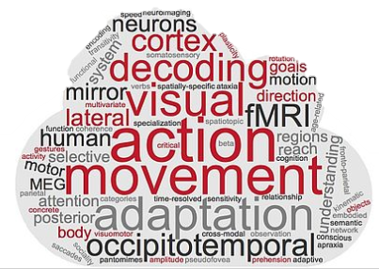
BrainNet Viewer
Day 3
Tonghe & Zuza

Slide 2
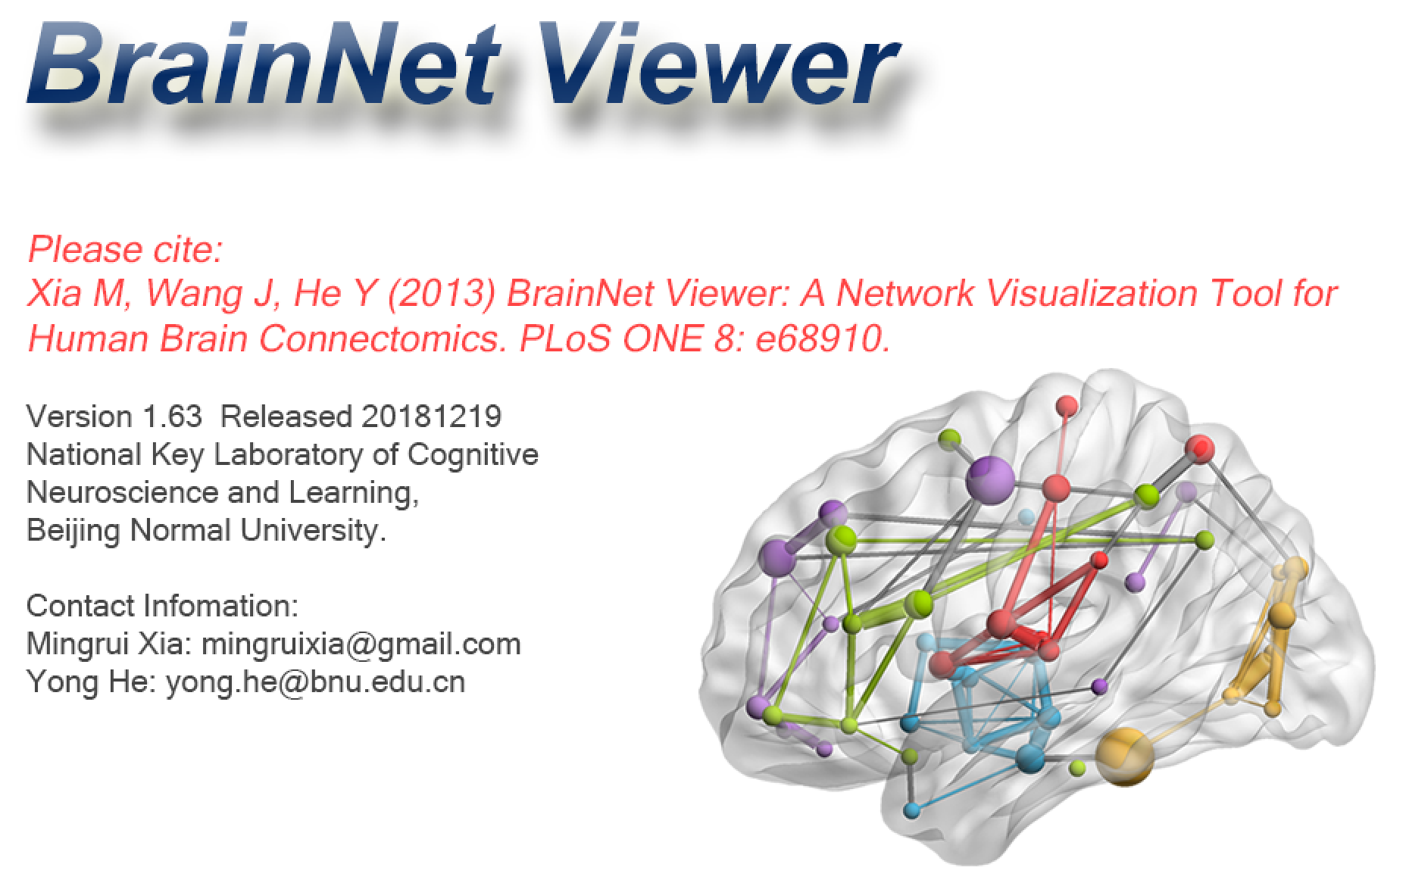
BrainNet Viewer A brain network visualization tool

Slide 3
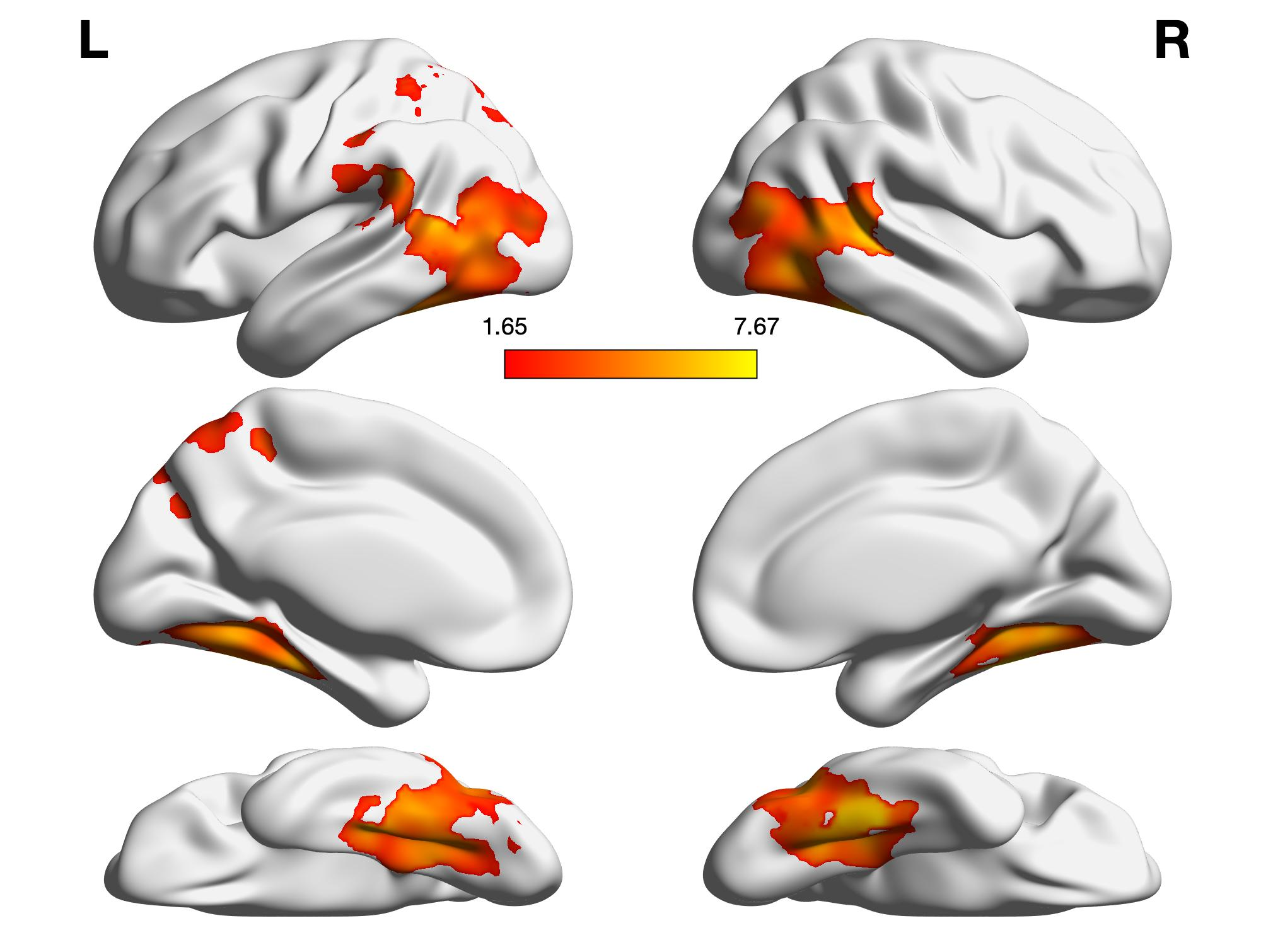
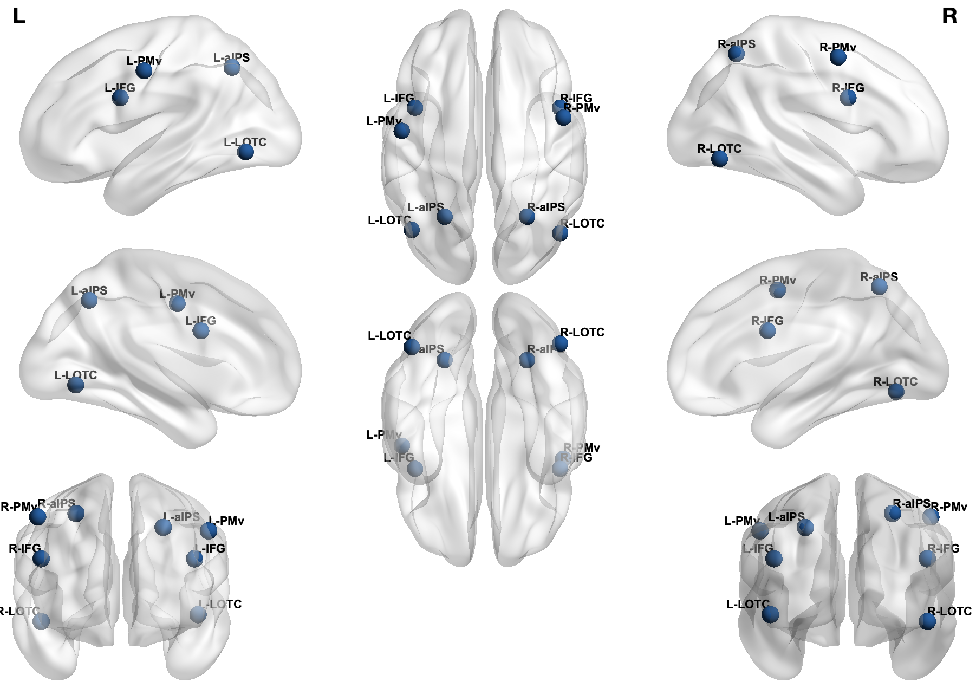
BrainNet Viewer
1. Visualization of brain maps
2. Visualization of ROIs

Slide 4
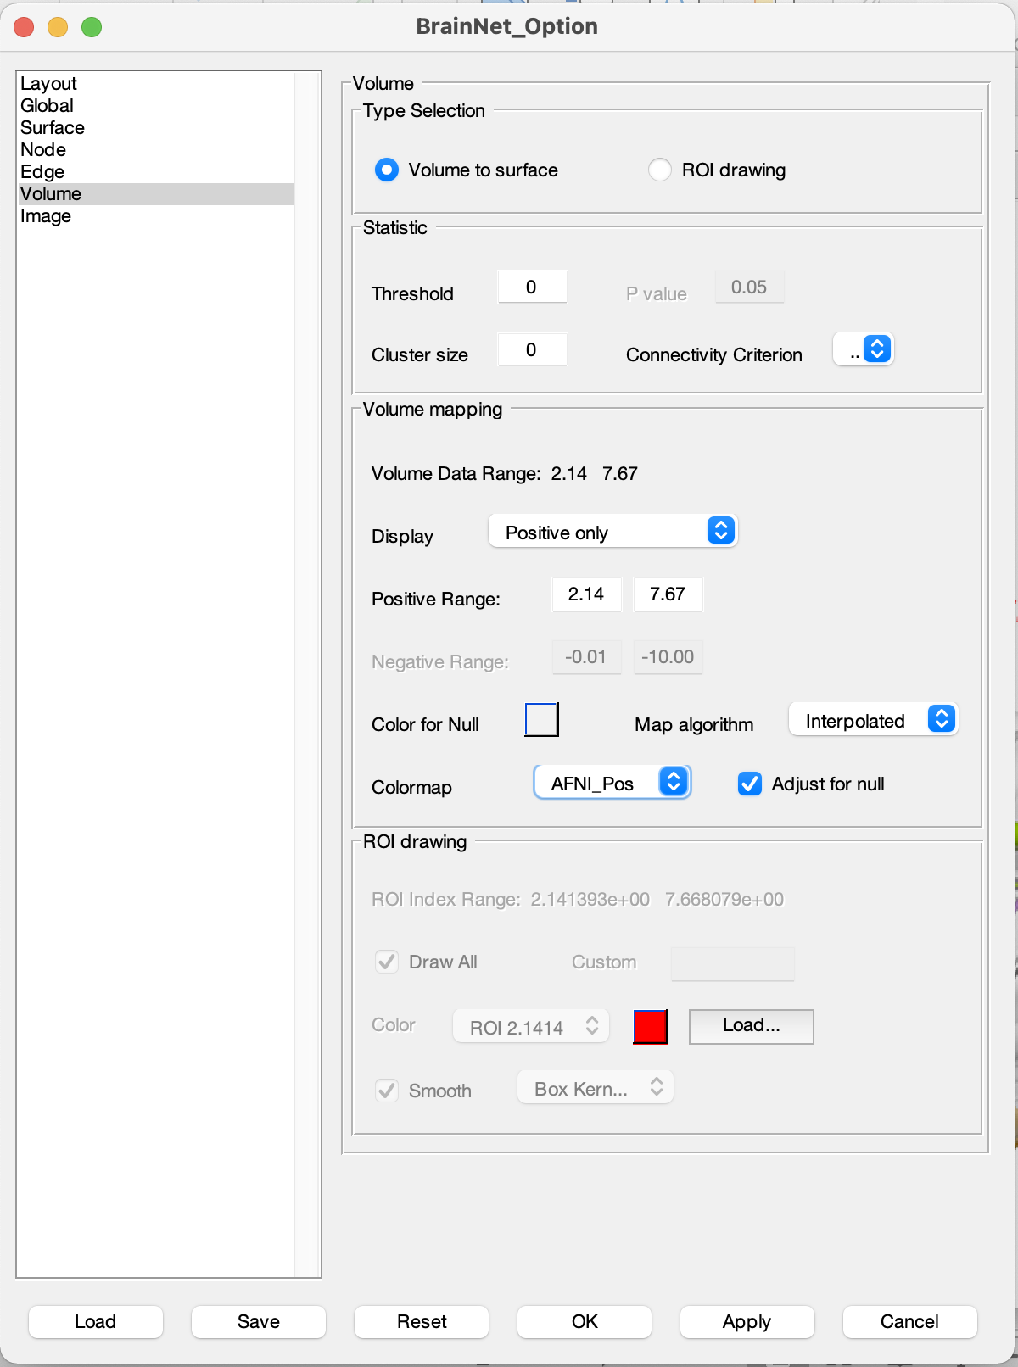
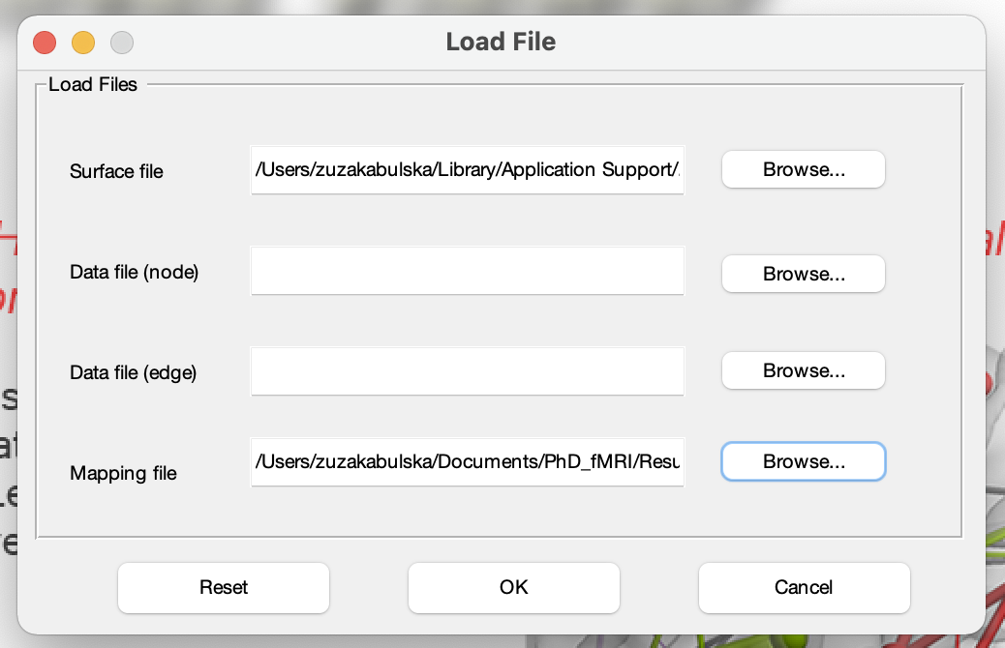
Visualization of brain maps
1.
2.

Slide 5
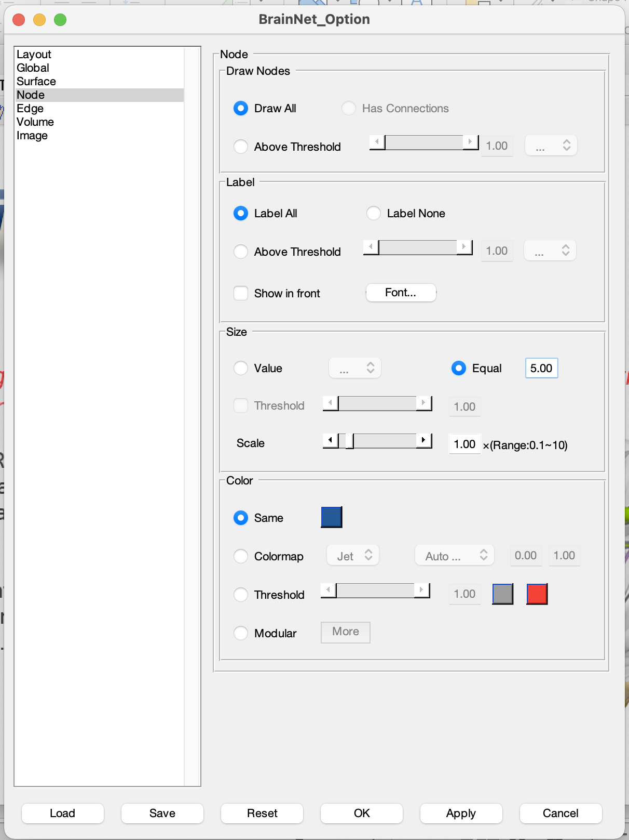
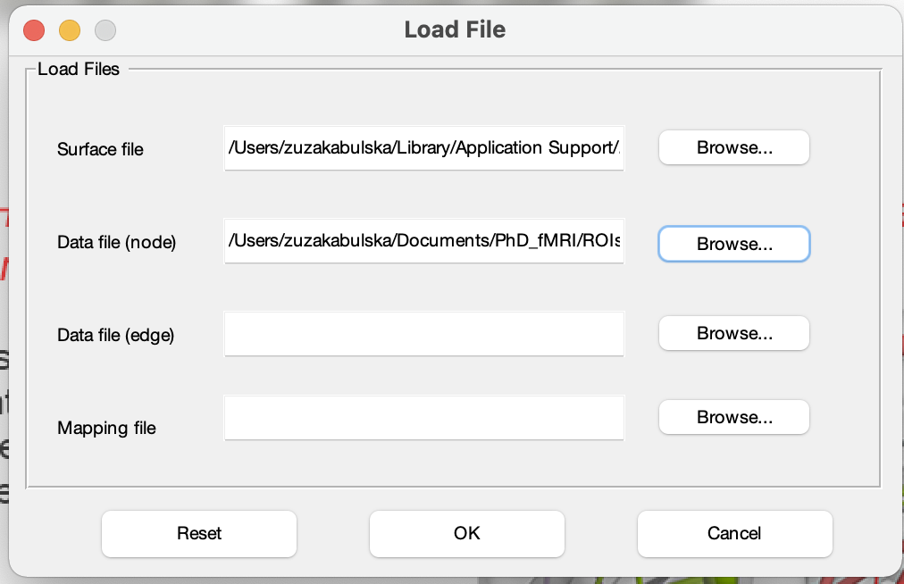
Visualization of ROIs
1.
2.

